Slide 1
School of Computing and Informatics Technology
Popular Encryption Schemes

Slide 2
Popular Encryption Schemes
Symmetric key encryption
Asymmetric key encryption
Pretty Good Privacy (PGP)
Secure Sockets Layer (SSL)
Muwonge S. Bernard, PhD
MCN 7103: System and Network Security

Slide 3
Symmetric Encryption
Use of only one key to encrypt information, rather than a public-private key system
    Same key is used to encrypt/decrypt a message
    Both sender and recipient must have same key
Not scalable
Very fast.
    Used to encrypt data not in transit, e.g., on hard drive
Single-key encryption requires sender to send decryption key to receiver
    Problem is of key distribution.
    Use of substitution ciphers can be way out.
Muwonge S. Bernard, PhD
MCN 7103: System and Network Security

Slide 4
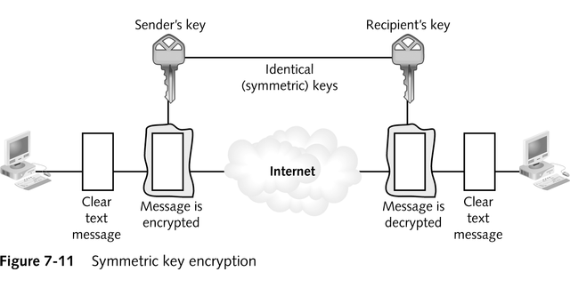
Symmetric Key Encryption
Muwonge S. Bernard, PhD
MCN 7103: System and Network Security

Slide 5
Asymmetric Encryption
Uses only one user’s public key and private key to generate unique session keys that are exchanged by users during a particular session
    Only the private key must be kept secret
Advantage
Scales better than symmetric encryption
Disadvantages
    Slower
    Only a few public key algorithms are available e.g,
      RSA (named after its inventors: Rivest, Shamir and Adleman) and
      EIGamal
    that are secure and easy to use for both encryption and key exchange
Muwonge S. Bernard, PhD
MCN 7103: System and Network Security

Slide 6
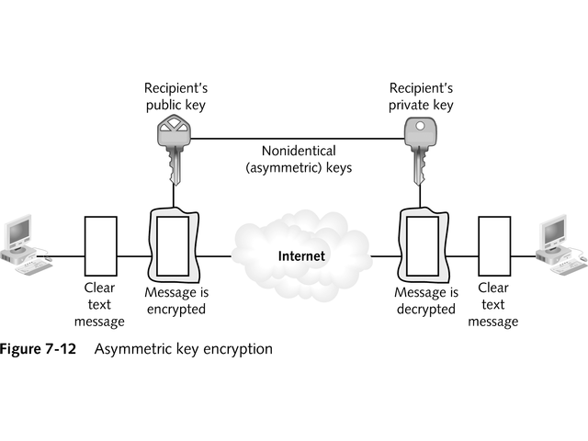
Asymmetric Key Encryption
Muwonge S. Bernard, PhD
MCN 7103: System and Network Security

Slide 7
Key distribution problem solved by public key cryptography.
    Sender creates a document – “plaintext”
    Sender encrypts file with recipient’s public key- “ciphertext”.
    Sender sends ciphertext to recipient.
    Recipient uses their secret key to decrypt ciphertext.
    Recipient now has the plaintext from sender.
Can also be used to encipher any digital file format, e.g., audio, images, etc…
Muwonge S. Bernard, PhD
MCN 7103: System and Network Security

Slide 8
Pretty Good Privacy(PGP)
Hybrid system that combines advantages of asymmetric (scalability) and symmetric (speed) encryption systems
Exists in free and commercial versions.
Helps you in
    Maintaining your privacy by encrypting your messages
    Authenticating yourself to others.
OpenPGP is a standards specification that guides the development of PGP.
Muwonge S. Bernard, PhD
MCN 7103: System and Network Security

Slide 9
PGP
Process
    File/message is encrypted
    Session key is encrypted using public key half of asymmetric public-private key pair
    Recipient of encrypted message uses his/her private key to decode the session key
    Session key is used to decode message/file
Encryption schemes used to generate public and private key pairs
    Rivest-Shamir-Adleman (RSA) encryption
      Very secure and widely used in e-commerce protocols.
    Diffie-Hellman encryption
      Cryptographic protocol that allows two parties to agree on a secret key over an insecure communications channel.
      Key can then be used to encrypt subsequent communications using a symmetric key cipher.
Muwonge S. Bernard, PhD
MCN 7103: System and Network Security

Slide 10
When a user encrypts plaintext with PGP, PGP first compresses the plaintext.
    This saves transmission time and disk space
    It also strengthens cryptographic security by enhancing resistance to cryptanalysis
      The attacker is forced to both decrypt and decompress on each brute force attack round increasing the time needed.
PGP then creates a one time only secret session key.
    This is a randomly generated number.
    It works with a very secure, fast conventional algorithm to encrypt the plaintext.
Session key is then encrypted to recipient’s public key.
Muwonge S. Bernard, PhD
MCN 7103: System and Network Security

Slide 11
Decryption
To decrypt, the recipient’s copy of PGP uses his private key to recover the temporary session key
PGP then uses this to decrypt the conventionally-encrypted ciphertext.
With this combination of public key and symmetric key cyptography, performance and key distribution are improved without sacrificing security.
Some PGP versions like PGP 6.0 provide the ability to create new encryption keys without sacrificing the master key and signatures collected on it.
Old sub keys may also be revoked independent of the key itself.
  This feature creates multiple sub keys that are set to be used during different periods of the key’s lifetime.
Muwonge S. Bernard, PhD
MCN 7103: System and Network Security

Slide 12
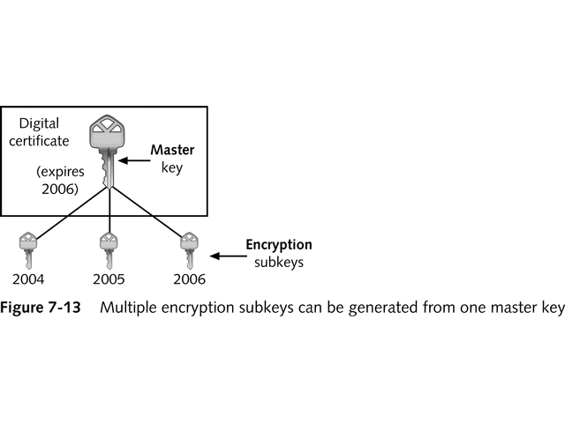
Using PGP
Example:
If you create a key that expires in 3 years, you may create 3 sub keys each used in one of the 3 years in the key’s lifetime.
This is a useful security measure and provides an automatic way to switch to a new encryption key periodically.
Muwonge S. Bernard, PhD
MCN 7103: System and Network Security

Slide 13
There are two requirements for secure use of conventional encryption:
  The opponent should be unable to decrypt cryptogram or discover the key even if he or she is in possession of a number of cryptograms together with the plaintext that produced each cryptogram.
  Sender and receiver must have obtained copies of the secret key in a secure fashion and must keep the key secure.
    Note: the security of conventional encryption depends on the secrecy of the key, not the secrecy of the algorithm
    The algorithm is supposed to be public.
Muwonge S. Bernard, PhD
MCN 7103: System and Network Security

Slide 14
Secure Socket Layer(SSL)
Secure way to transmit web based data
Has become part of an overall security protocol known as Transport Layer Security – TLS.
Uses both symmetric and asymmetric keys
    Asymmetric keys start an SSL session
    Symmetric keys are dynamically generated for the bulk of the transfer.
Internet security protocol used by Internet browsers and Web servers to transmit sensitive information.
In the browser, the http is replaced with https and you’ll see a small padlock in the status bar at the bottom of the browser window.
    This lets you know that you’re using encryption.
Muwonge S. Bernard, PhD
MCN 7103: System and Network Security

Slide 15
SSL
Use of SSL encryption is a common way to enhance the security of transactions conducted through a Website, i.e.,
    It secures web based transactions.
    Most of the SSL specifications have been adopted by IETF to create a new protocol; “TLS” for securing more than web based transactions.
SSL uses public key cryptography to secure transactions.
Muwonge S. Bernard, PhD
MCN 7103: System and Network Security

Slide 16
SSL Connections
Much as SSL can run over other ports, the default SSL port is 443 TCP.
To make an SSL connection to a web server to Port 443, a user should type https://www.example.com.
If the connection is to be made on a different port, the user types https://www.example.com:[port number]
The transactions between the user and the web server will then be encrypted.
Muwonge S. Bernard, PhD
MCN 7103: System and Network Security

Slide 17
Certificate generation
  The process of setting up an SSL connection on a web server varies depending on the type of web server being used but the backend functionality is the same across all web servers.
    The public/private key pair is generated on the web server.
    The private key is stored
    The public key is sent to a Certificate Authority (CA)
    The CA, e.g., VeriSign verifies the identity of the organization that sent the key and issues an x.509v3 certificate after signing it
    This certificate contains the organization’s public key.
    The newly generated certificate is installed on the web server
    SSL sessions can then begin.
Muwonge S. Bernard, PhD
MCN 7103: System and Network Security

Slide 18
NOTE:
SSL sessions will actually run without a certificate generated by a CA.
    The web browser will generate an error window when a user visits an SSL-encrypted website that has no CA-signed certificate.
    The error indicates that a trusted authority hasn’t signed the certificate, and so the information is suspect.
    The data sent between the user and the server is still encrypted but there’s no 3rd party verification that the website is owned by the organization that claims to own it.
Muwonge S. Bernard, PhD
MCN 7103: System and Network Security

Slide 19
When a user attempts to connect to a web server using SSL,
    The user initiates an SSL connection with the web server and tells the web server the minimum SSL version it will accept- say, v3.0
    The web server responds with a copy of the x.509v3 key.
    The web browser chooses a random symmetric key, encrypts it with the server’s x.509v3 key and sends it back to the web server
    The web server decrypts the symmetric key using the server’s private key.
    The web server and the client use this symmetric key to decrypt traffic during the SSL session.
        The web server also assigns a unique ID to each encrypted session, called an SSL Session ID.
        The SSL Session ID is unencrypted and sent between the user and the server with each request.
Muwonge S. Bernard, PhD
MCN 7103: System and Network Security

Slide 20
Note
SSL is a great tool for encrypting data between users and a web server.
It’s not a tool for securing data while on the web server.
SSL encryption should be used with other security measures as part of an overall web server security solution.
Muwonge S. Bernard, PhD
MCN 7103: System and Network Security

Slide 21
Difference between SSL and PGP
Two big differences are packaging and intended use.
    In both cases, the 'key' is just a big random number. However, surround data (i.e., domain, email address, signatures) differs between the two.
    Additionally in most cases an SSL public key* is intended to help secure an http or other network connection while a PGP public key* is intended to allow encryption of files and/or emails.
    Another difference is that almost all SSL key pairs are RSA keys, while many PGP key pairs are DH/DSA.
      (This describes how the public key and private key interrelate.)
Muwonge S. Bernard, PhD
MCN 7103: System and Network Security

Slide 22
References
Cryptography and Network Security: Principles and Practice, Third Edition, by William Stallings (2000)
http://technet.microsoft.com/en-us/library/dd361898.aspx
Muwonge S. Bernard, PhD
MCN 7103: System and Network Security
Notes:
The second, illustrated in Figure 1.6, model is concerned with controlled access to information or resources on a computer system, in the presence of possible opponents. Here appropriate controls are needed on the access and within the system, to provide suitable security. Some cryptographic techniques are useful here also.

Slide 23

Q & A
“In life, always expect questions, but do not expect answers”
Muwonge S. Bernard, PhD
MCN 7103: System and Network Security

